Slide 1



Test Automation using UiPath Test Suite – Developer Series
Part 4 of 4

Slide 2


Meet today’s team:
Diana Gray
Community Marketing Manager AMER
@UiPath
Atul Trikha
RPA Architect, COE Lead & Account Chief Technologist @Peraton

Slide 3
About today’s UiPath developer meeting:
AMER Developer Community sessions
Managed by UiPath MVPs in Canada, Latin America & USA
You are encouraged to network with MVPs and share your LinkedIn in the chat box. We want to get to know you
These sessions are for you to engage with us on topics that interest you or that you want to share with the UiPath Developer Community
Please use the chat to place questions until Q&A
If you have any topics that you want us to cover, please email diana.gray@uipath.com

Slide 4

Community.uipath.com

Slide 5

Community.uipath.com

Slide 6
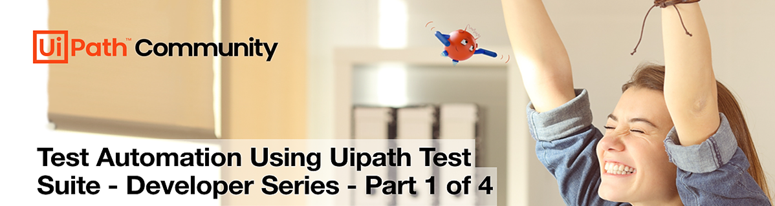


Date/Time | Topic | Status
July 12, 5 PM EDT | Test Automation using UiPath Test Suite - Developer Series - Part 1 of 4 | Recorded
July 19, 5 PM EDT | Test Automation using UiPath Test Suite - Developer Series - Part 2 of 4 | Recorded
July 26, 5 PM EDT | Test Automation using UiPath Test Suite - Developer Series - Part 3 of 4 | Recorded
Aug 2, 5 PM EDT | Test Automation using UiPath Test Suite - Developer Series - Part 4 of 4 | Happening
Register for Events at community.uipath.com

Slide 7
Coming Soon !!!!!!
Date/Time | Topic | Status
September 12, 6 PM EDT | REFramework: Overview - Developer Series - Part 1 of 4 | Register
September 19, 6 PM EDT | REFramework: Modify the Framework - Developer Series - Part 2 of 4 | Register
October 3, 6 PM EDT | REFramework: Queues, Configuration and Creating within the States - Developer Series - Part 3 of 4 | Register
October 10, 6 PM EDT | REFramework: Debugging/Workflow Analyzer/Validation - Developer Series - Part 4 of 4 | Register
Register for Events at community.uipath.com

Slide 8

Test Automation using UiPath Test Suite 4 Parts Developer Series
Part 1: Building Blocks, Test Suite Product Overview
Part 2: UiPath Test Suite Family of Products
Part 3: Deep Dive into Test Suite capabilities
Part 4: Open Discussion and Wrap up

Slide 9
Part 4: Test Suite Open Discussion and Wrap up
Create a simpler, smoother, and more productive testing experience.
Wrap-up with open Q&A
Notes:
UiPath Test Manager: Manage tests with comprehensive test planning, defect reporting, role-based access controls, and requirement traceability
UiPath Studio: Automate tests and test data generation by leveraging UiPath production-grade automation capabilities
UiPath Orchestrator: Distribute tests to schedule, monitor, and store dynamic test data and test execution & analyze detailed results
UiPath Test Robots: Execute tests on multiple machines in parallel and receive reports back
Guidance in setting the environment for Test Automation

Slide 10
End-to-End Walkthrough

Slide 11



Q & A

Slide 12






Understanding Roles, Responsibilities, and Product Mapping
Business Analyst / Manual Tester Manage Processes / Manage Tests Gather Requirements Design | RPA Developer / Test Developer / IT Professional Automate Processes / Automate Tests Build Deploy
Tes | t

Slide 13

Test Automation Best Practices
Test cases should be independent of each other. One test case should not depend on another test case’s run.
A test case should have one specific purpose only. Each test workflow should contain only one verification.
Every feature should have a unit test. If exceptions are allowed, create a separate test for each test case.
In a Given-When-Then test case structure, if the Given part is getting too extensive and unmanageable, try to redefine the test case. It could need more granularity or refactoring.
Maintain the test cases and update them after any change request.
Consider establishing a Test Management logic to have a single way of defining test cases.
To increase reusability between individual test projects, as well as between test and RPA projects, try to use libraries and object repositories, whenever possible.
Include the tests in the CI/CD pipeline.
Functional tests as part of your CI pipeline should be run as quickly as possible so as to not delay your build. Therefore, try to execute these tests in parallel on as many robots as possible.
Activity names should reflect the action taken. For non-obvious behaviors, consider using annotations on your activities.
Consider using detailed logging and exception handling to debug the process and avoid false negative results.
Plan for recovery or retry for errors at different stages to avoid failed results.
Consider having a folder structure dedicated to testing and using the same test case naming convention across your projects.
Use assets for variables that are likely to change and used many times.
For scenarios where an application’s state must be validated before proceeding with certain steps in a process, consider applying validation measures. These measures can include using extra activities that wait for the desired application state before other interactions (hardcoded delays are not considered good practice).
Consider using simulated click/ type or send windows messages, whenever possible.
Do not delete, move or rename the test cases outside of Studio. Perform these actions in Studio only. Use Import Test Cases in case there is a test case from another project that should be referenced.
16

Slide 14
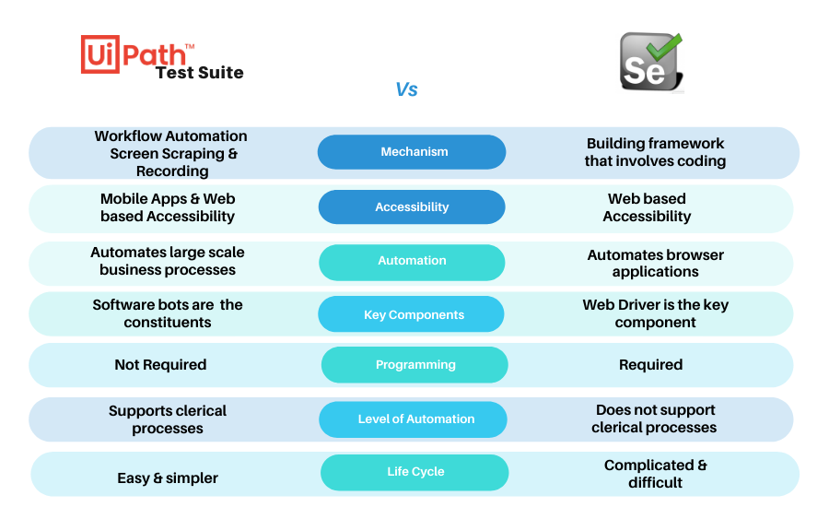
UiPath Test Suite vs Selenium

Slide 15









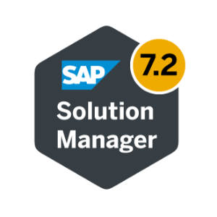


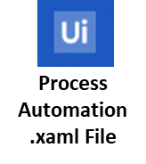

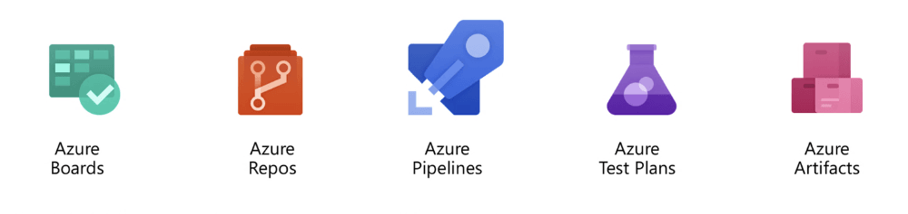

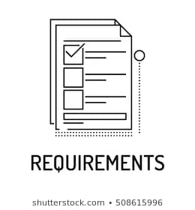
Best Practices Approach to RPA Testing
Do the work now to reduce Large Maintenance efforts in the future!
BUILD TIME PROCESS FLOW
Document
Test Cases
Production
Skeleton
.xaml File
Test
Test Sets and Test Data are Configured and Managed in Orchestrator
Development
Designs Tests and
Map to Business Requirements
Testing workflows are deployed
ALM Integrations
Functional Workflows
Link Test Cases
to Test Manager
Unit Tests
Testing Workflows
Developers
Business Users define Business Requirements
What is a successful RPA workflow?
(Speed, success rate, exception handling, etc.)
Notes:
(Best Practices for Testing while Building Workflows)

Slide 16





Best Practices Approach to Testing
How do tests run after development?
RUNTIME PROCESS FLOW
1
Testers can manually execute
Test Sets from Test Manager OR from Orchestrator.
Production
Test
2
Test Sets and Test Data are Configured and managed in Orchestrator
Test Sets can also be scheduled to run.
Development
3
Test Robots
Report results back to Test Manager
Execute Tests
Testing Bot Results
Testing workflows are deployed
If Tests Fail,
Tester logs defect
ALM Integrations
Functional Workflows
Unit Tests
Testing Workflows
During
Design-time
Developers

Slide 17
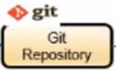

Best Practices Approach to RPA Testing
Continuous Testing and Continuous Deployment with ANY Change
RUNTIME PROCESS FLOW
CI/CD Tools
If RPA Tests Pass, changes can be migrated to Production
Version Control System
Production
3
2
Test
RPA Developer, App Developer, or Environment Owner Commits Code Changes
Test Sets and Test Data are Configured and Managed in Orchestrator
Development
1
Execute Tests
Testing Bot Results
Testing workflows are deployed
ALM Integrations
Functional Workflows
Unit Tests
Testing Workflows
During Runtime
Developers
Notes:
(Best Practices for Continuously Testing Workflows after they have been published and are running in production)

